Slide 1

MIT Art Design and Technology University MIT School of Computing, Pune
Third Year Engineering
21BTCS503 - Introduction to Data Science
Class - T.Y. Core (SEM-V)
Unit – IV (Data Analysis)

Slide 2
Unit IV - Syllabus
Unit IV –Data Analysis 09 hours
Data Analysis Theory and Methods: Clustering –Overview, K-means- overview of method, determining number of clusters, Association Rules- Overview of method, Apriori algorithm, evaluation of association rules, Regression-Overview of linear regression method, model description. Classification- Overview, Naïve Bayes classifier

Slide 3
What is Cluster Analysis?
Cluster: a collection of data objects
Similar to one another within the same cluster
Dissimilar to the objects in other clusters
Cluster analysis
Grouping a set of data objects into clusters
Clustering is unsupervised classification: no predefined classes
Typical applications
As a stand-alone tool to get insight into data distribution
As a preprocessing step for other algorithms

Slide 4
General Applications of Clustering
Pattern Recognition
Spatial Data Analysis
create thematic maps in GIS by clustering feature spaces
detect spatial clusters and explain them in spatial data mining
Image Processing
Economic Science (especially market research)
WWW
Document classification
Cluster Weblog data to discover groups of similar access patterns

Slide 5
Examples of Clustering Applications
Marketing: Help marketers discover distinct groups in their customer bases, and then use this knowledge to develop targeted marketing programs
Land use: Identification of areas of similar land use in an earth observation database
Insurance: Identifying groups of motor insurance policy holders with a high average claim cost
City-planning: Identifying groups of houses according to their house type, value, and geographical location
Earth-quake studies: Observed earth quake epicenters should be clustered along continent faults

Slide 6
What Is Good Clustering?
A good clustering method will produce high quality clusters with
high intra-class similarity
low inter-class similarity
The quality of a clustering result depends on both the similarity measure used by the method and its implementation.
The quality of a clustering method is also measured by its ability to discover some or all of the hidden patterns.

Slide 7
The K-Means Clustering Method
Given k, the k-means algorithm is implemented in four steps:
Partition objects into k nonempty subsets
Compute seed points as the centroids of the clusters of the current partition (the centroid is the center, i.e., mean point, of the cluster)
Assign each object to the cluster with the nearest seed point
Go back to Step 2, stop when no more new assignment

Slide 8
The K-Means Clustering Method
Example
10
10
9
9
8
8
7
7
6
6
5
5
4
Assign each objects to most similar center
Update the cluster means
4
3
3
2
2
1
1
0
0
0
1
2
3
4
5
6
7
8
9
10
0
1
2
3
4
5
6
7
8
9
10
reassign
reassign
K=2
Arbitrarily choose K object as initial cluster center
Update the cluster means

Slide 9
Comments on the K-Means Method
Strength: Relatively efficient: O(tkn), where n is # objects, k is # clusters, and t is # iterations. Normally, k, t << n.
Comparing: PAM: O(k(n-k)² ), CLARA: O(ks² + k(n-k))
Comment: Often terminates at a local optimum. The global optimum may be found using techniques such as: deterministic annealing and genetic algorithms
Weakness
Applicable only when mean is defined, then what about categorical data?
Need to specify k, the number of clusters, in advance
Unable to handle noisy data and outliers
Not suitable to discover clusters with non-convex shapes

Slide 10
Variations of the K-Means Method
A few variants of the k-means which differ in
Selection of the initial k means
Dissimilarity calculations
Strategies to calculate cluster means
Handling categorical data: k-modes (Huang’98)
Replacing means of clusters with modes
Using new dissimilarity measures to deal with categorical objects
Using a frequency-based method to update modes of clusters
A mixture of categorical and numerical data: k-prototype method

Slide 11
What is the problem of k-Means Method?
The k-means algorithm is sensitive to outliers !
Since an object with an extremely large value may substantially distort the distribution of the data.
K-Medoids: Instead of taking the mean value of the object in a cluster as a reference point, medoids can be used, which is the most centrally located object in a cluster.
10
10
9
9
8
8
7
7
6
6
5
5
4
4
3
3
2
2
1
1
0
0
1
2
3
4
5
6
7
8
9
10
0
0
1
2
3
4
5
6
7
8
9
10

Slide 12
What Is Association Mining?
Association rule mining:
Finding frequent patterns, associations, correlations, or causal structures among sets of items or objects in transaction databases, relational databases, and other information repositories.
Frequent pattern: pattern (set of items, sequence, etc.) that occurs frequently in a database [AIS93]
Motivation: finding regularities in data
What products were often purchased together? — Beer and diapers?!
What are the subsequent purchases after buying a PC?
What kinds of DNA are sensitive to this new drug?
Can we automatically classify web documents?

Slide 13
Why Is Frequent Pattern or Assoiciation Mining an Essential Task in Data Mining?
Foundation for many essential data mining tasks
Association, correlation, causality
Sequential patterns, temporal or cyclic association, partial periodicity, spatial and multimedia association
Associative classification, cluster analysis, iceberg cube, fascicles (semantic data compression)
Broad applications
Basket data analysis, cross-marketing, catalog design, sale campaign analysis
Web log (click stream) analysis, DNA sequence analysis, etc.

Slide 14
Basic Concepts: Frequent Patterns and Association Rules
Itemset X={x₁, …, x_{k}}
Find all the rules X🡪Y with min confidence and support
support, s, probability that a transaction contains X∪Y
confidence, c, conditional probability that a transaction having X also contains Y.
Transaction-id | Items bought
10 | A, B, C
20 | A, C
30 | A, D
40 | B, E, F
Customer
buys both
Customer
buys diaper
Let min_support = 50%, min_conf = 50%:
A 🡪 C (50%, 66.7%)
C 🡪 A (50%, 100%)
Customer
buys beer

Slide 15
Mining Association Rules—an Example
Transaction-id | Items bought
10 | A, B, C
20 | A, C
30 | A, D
40 | B, E, F
Min. support 50%
Min. confidence 50%
Frequent pattern | Support
{A} | 75%
{B} | 50%
{C} | 50%
{A, C} | 50%
For rule A ⇒ C:
support = support({A}∪{C}) = 50%
confidence = support({A}∪{C})/support({A}) = 66.6%

Slide 16
Apriori: A Candidate Generation-and-test Approach
Any subset of a frequent itemset must be frequent
if {beer, diaper, nuts} is frequent, so is {beer, diaper}
Every transaction having {beer, diaper, nuts} also contains {beer, diaper}
Apriori pruning principle: If there is any itemset which is infrequent, its superset should not be generated/tested!
Method:
generate length (k+1) candidate itemsets from length k frequent itemsets, and
test the candidates against DB
The performance studies show its efficiency and scalability
Agrawal & Srikant 1994, Mannila, et al. 1994

Slide 17
The Apriori Algorithm—An Example
Itemset | sup
{A} | 2
{B} | 3
{C} | 3
{D} | 1
{E} | 3
Database TDB
Itemset | sup
{A} | 2
{B} | 3
{C} | 3
{E} | 3
L₁
Tid | Items
10 | A, C, D
20 | B, C, E
30 | A, B, C, E
40 | B, E
C₁
1st scan
C₂
Itemset | sup
{A, B} | 1
{A, C} | 2
{A, E} | 1
{B, C} | 2
{B, E} | 3
{C, E} | 2
C₂
Itemset
{A, B}
{A, C}
{A, E}
{B, C}
{B, E}
{C, E}
L₂
Itemset | sup
{A, C} | 2
{B, C} | 2
{B, E} | 3
{C, E} | 2
2nd scan
C₃
Itemset
{B, C, E}
3rd scan
L₃
Itemset | sup
{B, C, E} | 2

Slide 18
The Apriori Algorithm
Pseudo-code:
C_{k}: Candidate itemset of size k
L_{k} : frequent itemset of size k
L₁ = {frequent items};
for (k = 1; L_{k} !=∅; k++) do begin
C_{k+1} = candidates generated from L_{k};
for each transaction t in database do
increment the count of all candidates in C_{k+1} that are contained in t
L_{k+1} = candidates in C_{k+1} with min_support
end
return ∪_{k} L_{k};

Slide 19
Important Details of Apriori
How to generate candidates?
Step 1: self-joining L_{k}
Step 2: pruning
How to count supports of candidates?
Example of Candidate-generation
L₃={abc, abd, acd, ace, bcd}
Self-joining: L₃*L₃
abcd from abc and abd
acde from acd and ace
Pruning:
acde is removed because ade is not in L₃
C₄={abcd}

Slide 20
How to Generate Candidates?
Suppose the items in L_{k-1} are listed in an order
Step 1: self-joining L_{k-1}
insert into C_{k}
select p.item₁, p.item₂, …, p.item_{k-1}, q.item_{k-1}
from L_{k-1} p, L_{k-1} q
where p.item₁=q.item₁, …, p.item_{k-2}=q.item_{k-2}, p.item_{k-1} < q.item_{k-1}
Step 2: pruning
forall itemsets c in C_{k} do
forall (k-1)-subsets s of c do
if (s is not in L_{k-1}) then delete c from C_{k}

Slide 21
How to Count Supports of Candidates?
Why counting supports of candidates a problem?
The total number of candidates can be very huge
One transaction may contain many candidates
Method:
Candidate itemsets are stored in a hash-tree
Leaf node of hash-tree contains a list of itemsets and counts
Interior node contains a hash table
Subset function: finds all the candidates contained in a transaction

Slide 22
Example: Counting Supports of Candidates
Subset function
Transaction: 1 2 3 5 6
3,6,9
1,4,7
2,5,8
1 + 2 3 5 6
1 3 + 5 6
2 3 4
5 6 7
1 4 5
3 4 5
3 5 6
3 5 7
6 8 9
3 6 7
3 6 8
1 3 6
1 2 + 3 5 6
1 2 4
4 5 7
1 2 5
4 5 8
1 5 9

Slide 23
Challenges of Frequent Pattern Mining
Challenges
Multiple scans of transaction database
Huge number of candidates
Tedious workload of support counting for candidates
Improving Apriori: general ideas
Reduce passes of transaction database scans
Shrink number of candidates
Facilitate support counting of candidates

Slide 24
Regression
Regression analysis is a statistical method to model the relationship between a dependent (target) and independent (predictor) variables with one or more independent variables.
More specifically, Regression analysis helps us to understand how the value of the dependent variable is changing corresponding to an independent variable when other independent variables are held fixed.
It predicts continuous/real values such as temperature, age, salary, price, etc.

Slide 25
Linear Regression
Linear regression algorithm shows a linear relationship between a dependent (y) and one or more independent (y) variables, hence called as linear regression.
Since linear regression shows the linear relationship, which means it finds how the value of the dependent variable is changing according to the value of the independent variable.
The linear regression model provides a sloped straight line representing the relationship between the variables.

Slide 26
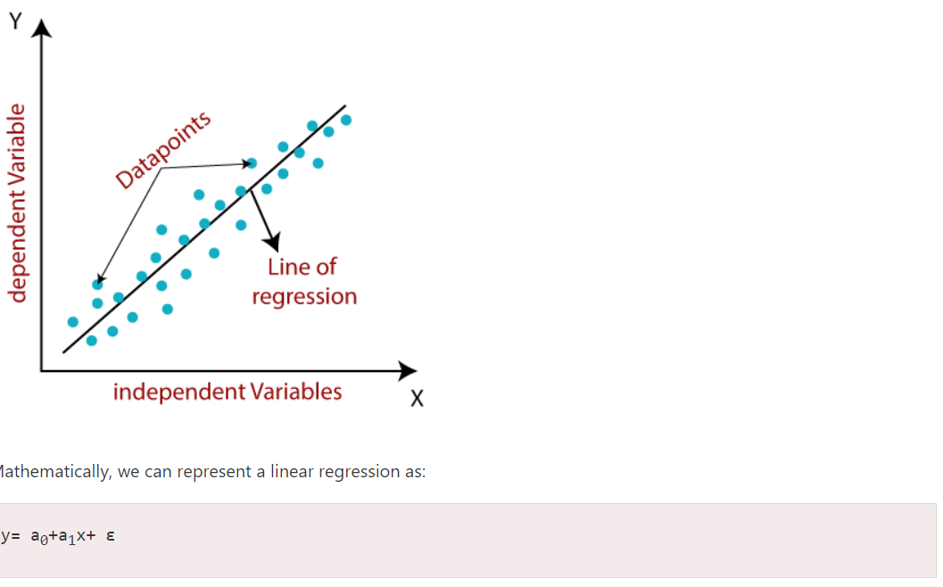
Linear Regression: Example
Here,
Y= Dependent Variable (Target Variable)
X= Independent Variable (predictor Variable)
a0= intercept of the line (Gives an additional degree of freedom)
a1 = Linear regression coefficient (scale factor to each input value).
ε = random error
The values for x and y variables are training datasets for Linear Regression model representation.

Slide 27
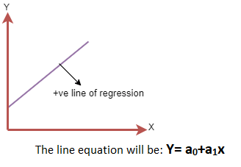
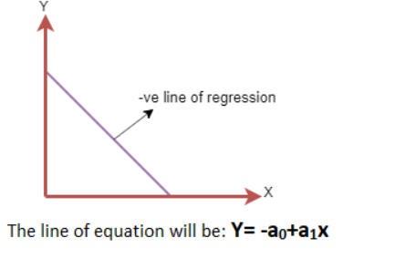
Linear Regression: Types
Positive Linear Relationship:
If the dependent variable increases on the Y-axis and independent variable increases on X-axis, then such a relationship is termed as a Positive linear relationship.
Negative Linear Relationship:
If the dependent variable decreases on the Y-axis and independent variable increases on the X-axis, then such a relationship is called a negative linear relationship.

Slide 28
Prediction Problems: Classification vs. Numeric Prediction
Classification
predicts categorical class labels (discrete or nominal)
classifies data (constructs a model) based on the training set and the values (class labels) in a classifying attribute and uses it in classifying new data
Numeric Prediction
models continuous-valued functions, i.e., predicts unknown or missing values
Typical applications
Credit/loan approval:
Medical diagnosis: if a tumor is cancerous or benign
Fraud detection: if a transaction is fraudulent
Web page categorization: which category it is

Slide 29
Classification—A Two-Step Process
Model construction: describing a set of predetermined classes
Each tuple/sample is assumed to belong to a predefined class, as determined by the class label attribute
The set of tuples used for model construction is training set
The model is represented as classification rules, decision trees, or mathematical formulae
Model usage: for classifying future or unknown objects
Estimate accuracy of the model
The known label of test sample is compared with the classified result from the model
Accuracy rate is the percentage of test set samples that are correctly classified by the model
Test set is independent of training set (otherwise overfitting)
If the accuracy is acceptable, use the model to classify new data
Note: If the test set is used to select models, it is called validation (test) set

Slide 30
Process (1): Model Construction
Classification
Algorithms
Training
Data
Classifier
(Model)
IF rank = ‘professor’
OR years > 6
THEN tenured = ‘yes’

Slide 31
Process (2): Using the Model in Prediction
Classifier
Testing
Data
Unseen Data
(Jeff, Professor, 4)
Tenured?

Slide 32
What is Classification?
Challenges
Multiple scans of transaction database
Huge number of candidates
Tedious workload of support counting for candidates
Improving Apriori: general ideas
Reduce passes of transaction database scans
Shrink number of candidates
Facilitate support counting of candidates

Slide 33
Bayesian Classification: Why?
A statistical classifier: performs probabilistic prediction, i.e., predicts class membership probabilities
Foundation: Based on Bayes’ Theorem.
Performance: A simple Bayesian classifier, naïve Bayesian classifier, has comparable performance with decision tree and selected neural network classifiers
Incremental: Each training example can incrementally increase/decrease the probability that a hypothesis is correct — prior knowledge can be combined with observed data
Standard: Even when Bayesian methods are computationally intractable, they can provide a standard of optimal decision making against which other methods can be measured

Slide 34
Bayes’ Theorem: Basics
Total probability Theorem:
Bayes’ Theorem:
Let X be a data sample (“evidence”): class label is unknown
Let H be a hypothesis that X belongs to class C
Classification is to determine P(H|X), (i.e., posteriori probability): the probability that the hypothesis holds given the observed data sample X
P(H) (prior probability): the initial probability
E.g., X will buy computer, regardless of age, income, …
P(X): probability that sample data is observed
P(X|H) (likelihood): the probability of observing the sample X, given that the hypothesis holds
E.g., Given that X will buy computer, the prob. that X is 31..40, medium income

Slide 35
Prediction Based on Bayes’ Theorem
Given training data X, posteriori probability of a hypothesis H, P(H|X), follows the Bayes’ theorem
Informally, this can be viewed as
posteriori = likelihood x prior/evidence
Predicts X belongs to C_{i} iff the probability P(C_{i}|X) is the highest among all the P(C_{k}|X) for all the k classes
Practical difficulty: It requires initial knowledge of many probabilities, involving significant computational cost

Slide 36
Classification Is to Derive the Maximum Posteriori
Let D be a training set of tuples and their associated class labels, and each tuple is represented by an n-D attribute vector X = (x₁, x₂, …, x_{n})
Suppose there are m classes C₁, C₂, …, C_{m}.
Classification is to derive the maximum posteriori, i.e., the maximal P(C_{i}|X)
This can be derived from Bayes’ theorem
Since P(X) is constant for all classes, only
needs to be maximized

Slide 37
Naïve Bayes Classifier
A simplified assumption: attributes are conditionally independent (i.e., no dependence relation between attributes):
This greatly reduces the computation cost: Only counts the class distribution
If A_{k} is categorical, P(x_{k}|C_{i}) is the # of tuples in C_{i} having value x_{k} for A_{k} divided by |C_{i, D}| (# of tuples of C_{i} in D)
If A_{k} is continous-valued, P(x_{k}|C_{i}) is usually computed based on Gaussian distribution with a mean μ and standard deviation σ
and P(x_{k}|C_{i}) is

Slide 38
Naïve Bayes Classifier: Training Dataset
Class:
C1:buys_computer = ‘yes’
C2:buys_computer = ‘no’
Data to be classified:
X = (age <=30,
Income = medium,
Student = yes
Credit_rating = Fair)

Slide 39
Naïve Bayes Classifier: An Example
P(C_{i}): P(buys_computer = “yes”) = 9/14 = 0.643
P(buys_computer = “no”) = 5/14= 0.357
Compute P(X|C_{i}) for each class
P(age = “<=30” | buys_computer = “yes”) = 2/9 = 0.222
P(age = “<= 30” | buys_computer = “no”) = 3/5 = 0.6
P(income = “medium” | buys_computer = “yes”) = 4/9 = 0.444
P(income = “medium” | buys_computer = “no”) = 2/5 = 0.4
P(student = “yes” | buys_computer = “yes) = 6/9 = 0.667
P(student = “yes” | buys_computer = “no”) = 1/5 = 0.2
P(credit_rating = “fair” | buys_computer = “yes”) = 6/9 = 0.667
P(credit_rating = “fair” | buys_computer = “no”) = 2/5 = 0.4
X = (age <= 30 , income = medium, student = yes, credit_rating = fair)
P(X|C_{i}) : P(X|buys_computer = “yes”) = 0.222 x 0.444 x 0.667 x 0.667 = 0.044
P(X|buys_computer = “no”) = 0.6 x 0.4 x 0.2 x 0.4 = 0.019
P(X|C_{i})*P(C_{i}) : P(X|buys_computer = “yes”) * P(buys_computer = “yes”) = 0.028
P(X|buys_computer = “no”) * P(buys_computer = “no”) = 0.007
Therefore, X belongs to class (“buys_computer = yes”)

Slide 40
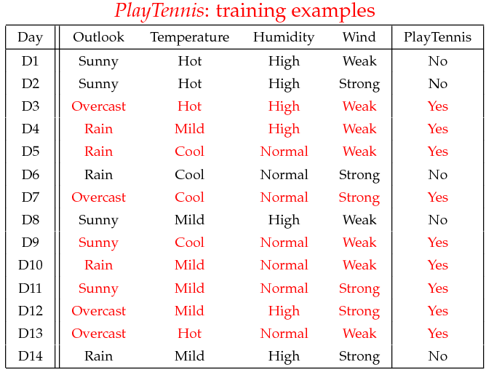
Naïve Bayes Classifier: An Example
Play Tennis

Slide 41
The learning phase for tennis example
P(Play=Yes) = 9/14
P(Play=No) = 5/14
We have four variables, we calculate for each we calculate the conditional probability table
Outlook | Play=Yes | Play=No
Sunny | 2/9 | 3/5
Overcast | 4/9 | 0/5
Rain | 3/9 | 2/5
Temperature | Play=Yes | Play=No
Hot | 2/9 | 2/5
Mild | 4/9 | 2/5
Cool | 3/9 | 1/5
Humidity | Play=Yes | Play=No
High | 3/9 | 4/5
Normal | 6/9 | 1/5
Wind | Play=Yes | Play=No
Strong | 3/9 | 3/5
Weak | 6/9 | 2/5

Slide 42
The test phase for the tennis example
Test Phase
Given a new instance of variable values,
x’=(Outlook=Sunny, Temperature=Cool, Humidity=High, Wind=Strong)
Given calculated Look up tables
P(Outlook=Sunny|Play=Yes) = 2/9
P(Temperature=Cool|Play=Yes) = 3/9
P(Huminity=High|Play=Yes) = 3/9
P(Wind=Strong|Play=Yes) = 3/9
P(Play=Yes) = 9/14
P(Outlook=Sunny|Play=No) = 3/5
P(Temperature=Cool|Play==No) = 1/5
P(Huminity=High|Play=No) = 4/5
P(Wind=Strong|Play=No) = 3/5
P(Play=No) = 5/14
P(Yes|x’): [P(Sunny|Yes)P(Cool|Yes)P(High|Yes)P(Strong|Yes)]P(Play=Yes) = 0.0053
P(No|x’): [P(Sunny|No) P(Cool|No)P(High|No)P(Strong|No)]P(Play=No) = 0.0206
Given the fact P(Yes|x’) < P(No|x’), we label x’ to be “No”.

Slide 43
Avoiding the Zero-Probability Problem
Naïve Bayesian prediction requires each conditional prob. be non-zero. Otherwise, the predicted prob. will be zero
Ex. Suppose a dataset with 1000 tuples, income=low (0), income= medium (990), and income = high (10)
Use Laplacian correction (or Laplacian estimator)
Adding 1 to each case
Prob(income = low) = 1/1003
Prob(income = medium) = 991/1003
Prob(income = high) = 11/1003
The “corrected” prob. estimates are close to their “uncorrected” counterparts

Slide 44
Naïve Bayes Classifier: Comments
Advantages
Easy to implement
Good results obtained in most of the cases
Disadvantages
Assumption: class conditional independence, therefore loss of accuracy
Practically, dependencies exist among variables
E.g., hospitals: patients: Profile: age, family history, etc.
Symptoms: fever, cough etc., Disease: lung cancer, diabetes, etc.
Dependencies among these cannot be modeled by Naïve Bayes Classifier
How to deal with these dependencies? Bayesian Belief Networks (Chapter 9)

Slide 45
The independence hypothesis…
… makes computation possible
… yields optimal classifiers when satisfied
… but is seldom satisfied in practice, as attributes (variables) are often correlated.
Attempts to overcome this limitation:
Bayesian networks, that combine Bayesian reasoning with causal relationships between attributes
Decision trees, that reason on one attribute at a time, considering most important attributes first

